Slide 1
Java Polymorphism
Instructor :Prashant Mishra
BIAS Bhimtal

Slide 2
Polymorphism in Java
Polymorphism in Java is a concept by which we can perform a single action in different ways. Polymorphism is derived from 2 Greek words: poly and morphs. The word "poly" means many and "morphs" means forms. So polymorphism means many forms.
There are two types of polymorphism in Java: compile-time polymorphism and runtime polymorphism. We can perform polymorphism in java by method overloading and method overriding.
If you overload a static method in Java, it is the example of compile time polymorphism.
Runtime polymorphism or Dynamic Method Dispatch is a process in which a call to an overridden method is resolved at runtime rather than compile-time.

Slide 3
Method Overloading in Java
If a class has multiple methods having same name but different in parameters, it is known as Method Overloading.
Suppose you have to perform addition of the given numbers but there can be any number of arguments, if you write the method such as a(int,int) for two parameters, and b(int,int,int) for three parameters then it may be difficult for you as well as other programmers to understand the behavior of the method because its name differs.
Different ways to overload the method
There are two ways to overload the method in java
By changing number of arguments
By changing the data type
In java, Method Overloading is not possible by changing the return type of the method only.

Slide 4
1) Method Overloading: changing no. of arguments
In this example, we have created two methods, first add() method performs addition of two numbers and second add method performs addition of three numbers.
In this example, we are creating static methods so that we don't need to create instance for calling methods.
class Adder{
static int add(int a,int b){return a+b;}
static int add(int a,int b,int c){return a+b+c;}
}
class TestOverloading1{
public static void main(String[] args){
System.out.println(Adder.add(11,11));
System.out.println(Adder.add(11,11,11));
}}
Output:
22
33

Slide 5
2) Method Overloading: changing data type of arguments
In this example, we have created two methods that differs in data type. The first add method receives two integer arguments and second add method receives two double arguments.
class Adder{
static int add(int a, int b){return a+b;}
static double add(double a, double b){return a+b;}
}
class TestOverloading2{
public static void main(String[] args){
System.out.println(Adder.add(11,11));
System.out.println(Adder.add(12.3,12.6));
}}
Output:
22
24.9

Slide 6
Q) Why Method Overloading is not possible by changing the return type of method only?
In java, method overloading is not possible by changing the return type of the method only because of ambiguity. Let's see how ambiguity may occur:
class Adder{
static int add(int a,int b){return a+b;}
static double add(int a,int b){return a+b;}
}
class TestOverloading3{
public static void main(String[] args){
System.out.println(Adder.add(11,11));//ambiguity
}}
Output:
Compile Time Error: method add(int,int) is already defined in class Adder
System.out.println(Adder.add(11,11));//Here, how can java determine which sum() method should be called?

Slide 7
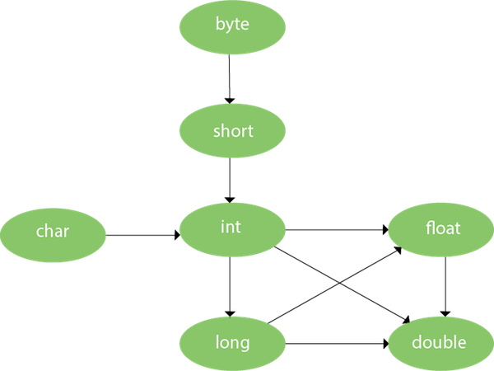
Method Overloading and Type Promotion
One type is promoted to another implicitly if no matching data type is found. Let's understand the concept by the figure given below:
As displayed in the above diagram, byte can be promoted to short, int, long, float or double. The short data type can be promoted to int , long, float or double. The char data type can be promoted to int , long ,float or double and so on.

Slide 8
Example of Method Overloading with Type Promotion

Slide 9
Example of Method Overloading with Type Promotion if matching found

Slide 10
Method Overriding in Java
If subclass (child class) has the same method as declared in the parent class, it is known as method overriding in Java.
In other words, If a subclass provides the specific implementation of the method that has been declared by one of its parent class, it is known as method overriding.

Slide 11
Usage of Java Method Overriding
Method overriding is used to provide the specific implementation of a method which is already provided by its super class.
Method overriding is used for runtime polymorphism.
Rules for Java Method Overriding
The method must have the same name as in the parent class
The method must have the same parameter as in the parent class.
There must be an IS-A relationship (inheritance).

Slide 12
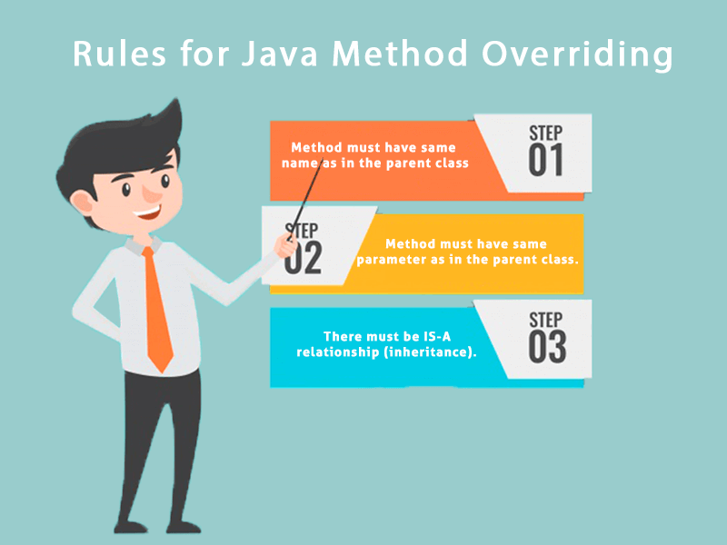

Slide 13
Understanding the problem without method overriding
Let's understand the problem that we may face in the program if we don't use method overriding.
//Java Program to demonstrate why we need method overriding
//Here, we are calling the method of parent class with child
//class object.
//Creating a parent class
class Vehicle{
void run(){System.out.println("Vehicle is running");}
}
//Creating a child class
class Bike extends Vehicle{
public static void main(String args[]){
//creating an instance of child class
Bike obj = new Bike();
//calling the method with child class instance
obj.run();
}
}
Output:
Vehicle is running

Slide 14
Example of method overriding
In this example, we have defined the run method in the subclass as defined in the parent class but it has some specific implementation. The name and parameter of the method are the same, and there is IS-A relationship between the classes, so there is method overriding.

Slide 15
//Java Program to illustrate the use of Java Method Overriding
//Creating a parent class.
class Vehicle{
//defining a method
void run(){System.out.println("Vehicle is running");}
}
//Creating a child class
class Bike2 extends Vehicle{
//defining the same method as in the parent class
void run(){System.out.println("Bike is running safely");}
public static void main(String args[]){
Bike2 obj = new Bike2();//creating object
obj.run();//calling method
}
}
Output:
Bike is running safely

Slide 16
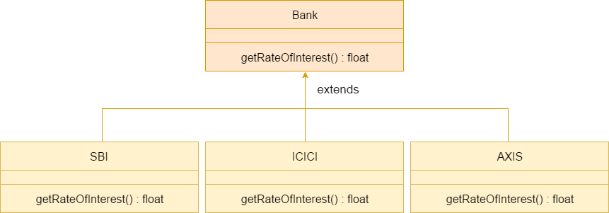
A real example of Java Method Overriding

Slide 17
Java Program to demonstrate the real scenario of Java Method Overriding
//where three classes are overriding
//the method of a parent class.
//Creating a parent class.
class Bank{
int getRateOfInterest(){return 0;}
}
//Creating child classes.
class SBI extends Bank{
int getRateOfInterest(){return 8;}
}
class ICICI extends Bank{
int getRateOfInterest(){return 7;}
}
class AXIS extends Bank{
int getRateOfInterest(){return 9;}
}
//Test class to create objects and call the methods
class Test2{
public static void main(String args[]){
SBI s=new SBI();
ICICI i=new ICICI();
AXIS a=new AXIS();
System.out.println("SBI Rate of Interest: "+s.getRateOfInterest());
System.out.println("ICICI Rate of Interest: "+i.getRateOfInterest());
System.out.println("AXIS Rate of Interest: "+a.getRateOfInterest());
}
}
Output:
SBI Rate of Interest: 8
ICICI Rate of Interest: 7
AXIS Rate of Interest: 9

Slide 18
Can we override static method?
No, a static method cannot be overridden. It is because the static method is bound with class whereas instance method is bound with an object. Static belongs to the class area, and an instance belongs to the heap area.
Can we override java main method?
No, because the main is a static method.

Slide 19
Difference between method overloading and method overriding in java
No. | Method Overloading | Method Overriding
1) | Method overloading is used to increase the readability of the program. | Method overriding is used to provide the specific implementation of the method that is already provided by its super class.
2) | Method overloading is performed within class. | Method overriding occurs in two classes that have IS-A (inheritance) relationship.
3) | In case of method overloading, parameter must be different. | In case of method overriding, parameter must be same.
4) | Method overloading is the example of compile time polymorphism. | Method overriding is the example of run time polymorphism.
5) | In java, method overloading can't be performed by changing return type of the method only. Return type can be same or different in method overloading. But you must have to change the parameter. | Return type must be same or covariant in method overriding.

Slide 20
Super Keyword in Java
The super keyword in Java is a reference variable which is used to refer immediate parent class object.
Whenever you create the instance of subclass, an instance of parent class is created implicitly which is referred by super reference variable.
Usage of Java super Keyword
super can be used to refer immediate parent class instance variable.
super can be used to invoke immediate parent class method.
super() can be used to invoke immediate parent class constructor.

Slide 21
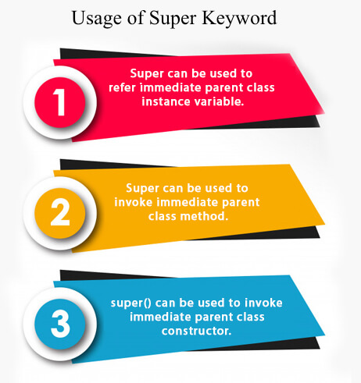

Slide 22
1) super is used to refer immediate parent class instance variable.
We can use super keyword to access the data member or field of parent class. It is used if parent class and child class have same fields.
class Animal{
String color="white";
}
class Dog extends Animal{
String color="black";
void printColor(){
System.out.println(color);//prints color of Dog class
System.out.println(super.color);//prints color of Animal class
}
}
class TestSuper1{
public static void main(String args[]){
Dog d=new Dog();
d.printColor();
}}
Output:
black
white
In the above example, Animal and Dog both classes have a common property color. If we print color property, it will print the color of current class by default. To access the parent property, we need to use super keyword.

Slide 23
2) super can be used to invoke parent class method
The super keyword can also be used to invoke parent class method. It should be used if subclass contains the same method as parent class. In other words, it is used if method is overridden.
class Animal{
void eat(){System.out.println("eating...");}
}
class Dog extends Animal{
void eat(){System.out.println("eating bread...");}
void bark(){System.out.println("barking...");}
void work(){
super.eat();
bark();
}
}
class TestSuper2{
public static void main(String args[]){
Dog d=new Dog();
d.work();
}}
In this example Animal and Dog both classes have eat() method if we call eat() method from Dog class, it will call the eat() method of Dog class by default because priority is given to local.
To call the parent class method, we need to use super keyword.
Output:
eating...
barking...

Slide 24
3) super is used to invoke parent class constructor.
class Animal{
Animal(){System.out.println("animal is created");}
}
class Dog extends Animal{
Dog(){
super();
System.out.println("dog is created");
}
}
class TestSuper3{
public static void main(String args[]){
Dog d=new Dog();
}}
Output:
animal is created
dog is created
Note: super() is added in each class constructor automatically by compiler if there is no super() or this().

Slide 25
super example: real use
class Person{
int id;
String name;
Person(int id,String name){
this.id=id;
this.name=name;
}
}
class Emp extends Person{
float salary;
Emp(int id,String name,float salary){
super(id,name);//reusing parent constructor
this.salary=salary;
}
void display(){System.out.println(id+" "+name+" "+salary);}
}
class TestSuper5{
public static void main(String[] args){
Emp e1=new Emp(1,"ankit",45000f);
e1.display();
}}
Output:
1 ankit 45000

Slide 26
Final Keyword In Java
The final keyword in java is used to restrict the user. The java final keyword can be used in many context. Final can be:
variable
method
class
The final keyword can be applied with the variables, a final variable that have no value it is called blank final variable or uninitialized final variable. It can be initialized in the constructor only. The blank final variable can be static also which will be initialized in the static block only. We will have detailed learning of these. Let's first learn the basics of final keyword.

Slide 27
Java final variable
If you make any variable as final, you cannot change the value of final variable(It will be constant).
Example of final variable
There is a final variable speedlimit, we are going to change the value of this variable, but It can't be changed because final variable once assigned a value can never be changed.
---------------------------------------------------------------------------------------------
class Bike9{
final int speedlimit=90;//final variable
void run(){
speedlimit=400;
}
public static void main(String args[]){
Bike9 obj=new Bike9();
obj.run();
}
}//end of class
Output : Compile Time Error

Slide 28
Java final method
If you make any method as final, you cannot override it.
--------------------------------------------------------------------------------------------
class Bike{
final void run(){System.out.println("running");}
}
class Honda extends Bike{
void run(){System.out.println("running safely with 100kmph");}
public static void main(String args[]){
Honda honda= new Honda();
honda.run();
}
}
Output : Compile Time Error

Slide 29
Java final class
If you make any class as final, you cannot extend it.
------------------------------------------------------------------------------------
final class Bike{}
class Honda1 extends Bike{
void run(){System.out.println("running safely with 100kmph");}
public static void main(String args[]){
Honda1 honda= new Honda1();
honda.run();
}
}
Output : Compile Time Error

Slide 30
Q) Is final method inherited?
Yes, final method is inherited but you cannot override it.
Q) What is blank or uninitialized final variable?
A final variable that is not initialized at the time of declaration is known as blank final variable.
Q.) Can we initialize blank final variable?
Yes, but only in constructor.
Q) Can we declare a constructor final?
No, because constructor is never inherited.

